Slide 1
Introduction to R and R studio
Maptime Milehigh

Slide 2
Agenda
Introduction to Maptime
What is R and Why Should you Use It?
Brief Intro to FOSS4G
Getting Started with R
R Demo
Q &A

Slide 3
What is R and Why should you use it?
R is a language for data science! Its main focus is on statistical computing.
R is an Free and Open Source Software
It runs on multiple OS.
R is useful for data science and geoscience and statistical analysis for the following reasons:
R can handle large datasets ( ‘Big data’)
R can make maps right in R studio!
R can connect to APIs ( like the Census API)

Slide 4
Brief Intro to FOSS4G
Or why you should stop using All ESRI Products

Slide 5




Introduction to FOSS4G
What does FOSS4G Mean?
Free Open Source Software
FOSS4G Projects ( both OSGeo and Non)
R and R studio
Qgis or just Q
GeoDa
GDAL/OGR
PostGIS
Numpy
The FOSS4G Community:
OSGeo
Maptime
GISTribe
GIS Stack Exchange

Slide 6
Getting Started with R and Rstudio

Slide 7
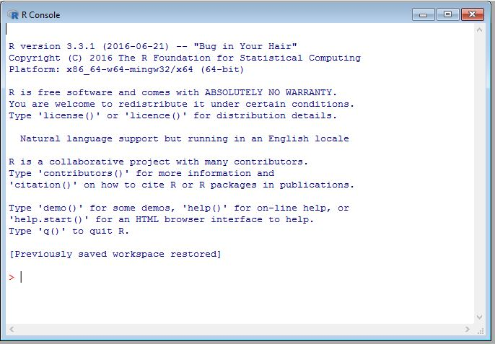
Getting Started with R
All the info for Downloading Data and the Software is on the Meetup page ☺
Lets start by talking about the differences between R and R Studio:
R comes with a terminal; You can use this to carry out R commands

Slide 8
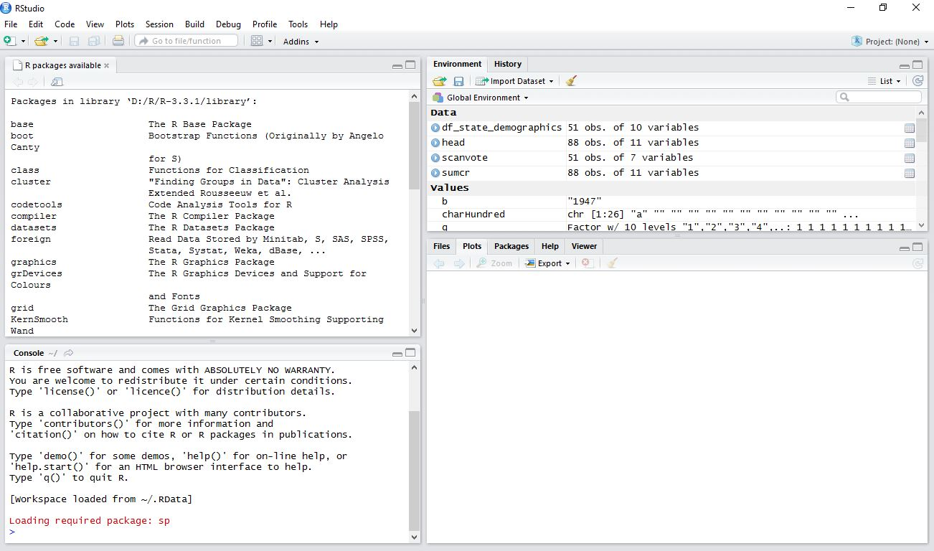
R studio
R Studio However is a more versatile GUI allowing user better control over their scripting:
Fills in package commands
The Plots window allows you to see your commands carried out in real time.
The other windows in this space, such as files, packages, help and viewer allows for easier access to know what is going on with your data and what packages you are using and which packages come with a library.

Slide 9
R Packages
R packages are functions and datasets that have been developed by the community.
Some basic R Packages include:
SP
ggplot
Cartogram
Corrogram
Maptools
Mapiew
Mapproj
Maps
This is a very small sample of the various R packages that you can use to conduct data analysis.
Notes:
There are hundreds of packages, packages can be found in various repos ( github, where you downloaded this presentation is one of them) CRAN is another place where you can find packages. CRAN has a standard for packages, because of this these packages are often sound and stable.

Slide 10
R studio Demo
Creating a Census Map with R.

Slide 11
Set Working Directory and Install Packages
Step 1: Set Working directory in R Studio:
setwd() type in the path name for your data files and hit enter.
Tools→ Working Directory → this will open a dialog box for you to select the file where your data files are stored.
Step 2: Install Packages
For this demo you will install the following packages:
​install.packages(c("choroplethr", "choroplethrMaps"))
library(choroplethr)

Slide 12
Step 3 and 4: Import your Data and Create a Box Plot
Step 3: Import and Look at your data:
data(df_state_demographics)
colnames(df_state_demographics)
Note: You can review your files within R studio, without opening up the CSV file.
Note: You can learn more about the data by typing: ?df_state_demographics
Step 4: Create a Box Plot of per Capita Income
boxplot(df_state_demographics$per_capita_income)
Note: Packages only work if you are connected to the internet!

Slide 13
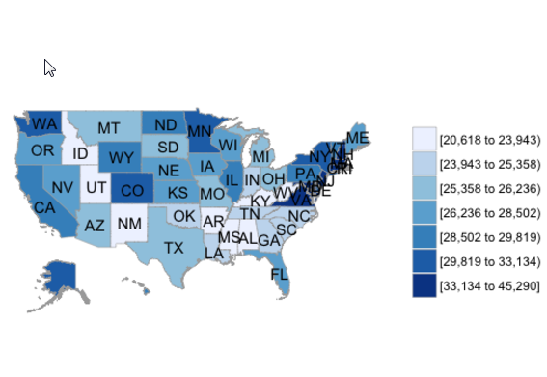
Step 5: Mapping The Data
In order to map the data we will use the state_choropleth function.
This function requires a data frame and some columns identified
Step 5: Mapping The data
df_state_demographics$value = df_state_demographics$per_capita_income ​state_choropleth(df_state_demographics)

